Slide 1


CODE AND BLOCK ASSIGNMENT ON SOLID PRINCIPLE
Presented By : Shashikant Tanti

Slide 2
SOLID: The First 5 Principles of Object Oriented Design
Introduction
SOLID is an acronym for the first five object-oriented design (OOD) principles by Robert C. Martin (also known as Uncle Bob).
These principles establish practices that lend to developing software with considerations for maintaining and extending as the project grows. Adopting these practices can also contribute to avoiding code smells, refactoring code, and Agile or Adaptive software development.
SOLID stands for:
S - Single-responsiblity Principle
O - Open-closed Principle
L - Liskov Substitution Principle
I - Interface Segregation Principle
D - Dependency Inversion Principle

Slide 3
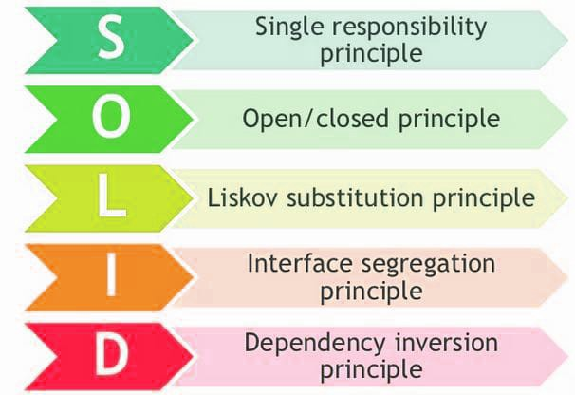

Slide 4
1. Single-Responsibility Principle
Single-responsibility Principle (SRP) states:
A class should have one and only one reason to change, meaning that a class should have only one job
The single-responsibility principle (SRP) is a computer-programming principle that states that every module, class or function in a computer program should have responsibility over a single part of that program's functionality, and it should encapsulate that part. ... Hence, each module should be responsible for each role.

Slide 5
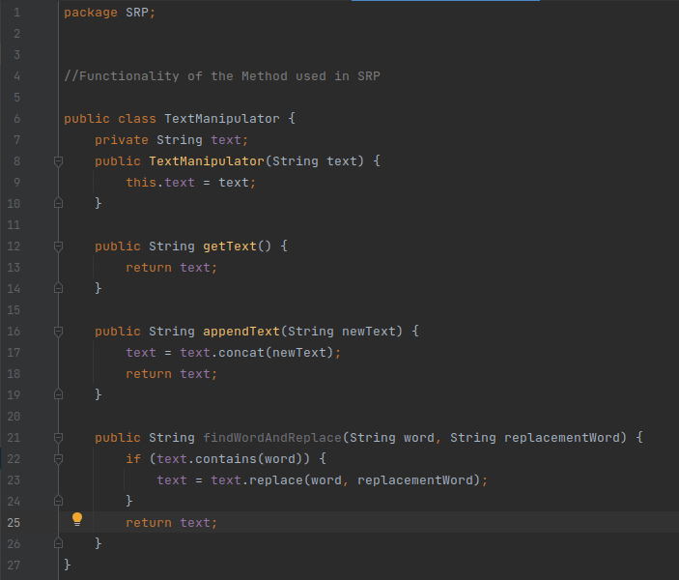
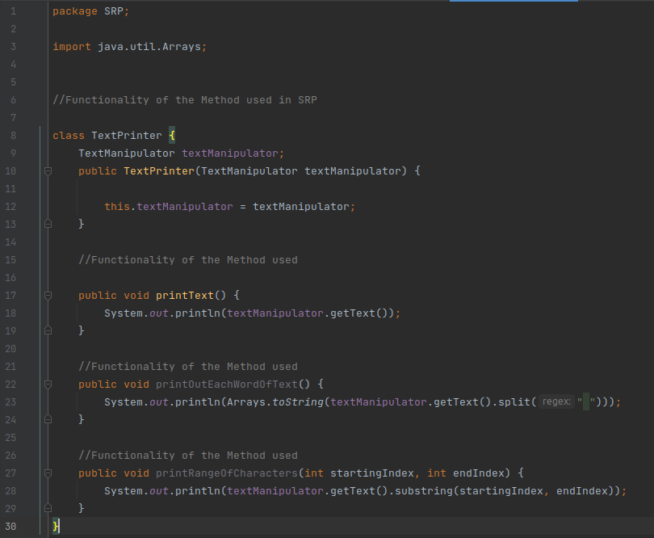
Let’s see an example of SRP.
Here the 2 classes having 2 functions:-TextManipulator(), and TextPrinter().

Slide 6
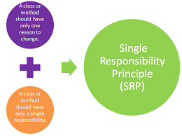
The goal is to input a String from User and modify it (reverse in this case) and print the String. Adding all the functionalities to the same class will serve the basic purpose but will lead to a problem when there is error in any one function, viz. the reverse function. There will also be problem when we want to add more functions or modify the existing one:-
The single responsibility principle provides another substantial benefit. Classes, software components and microservices that have only one responsibility are much easier to explain, understand and implement than the ones that provide a solution for everything

Slide 7
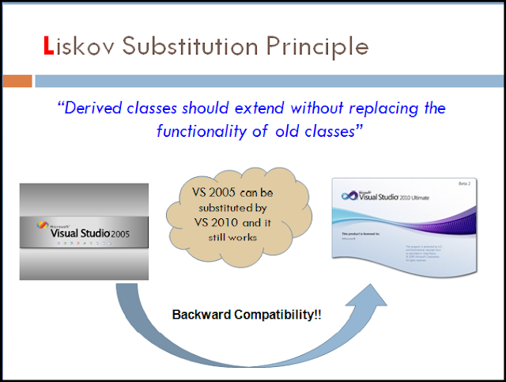
2.The Liskov Substitution Principle:-
The principle says that subtypes must be substitutable for their base types.:-
The principle defines that objects of a superclass shall be replaceable with objects of its subclasses without breaking the application. That requires the objects of your subclasses to behave in the same way as the objects of your superclass.

Slide 8
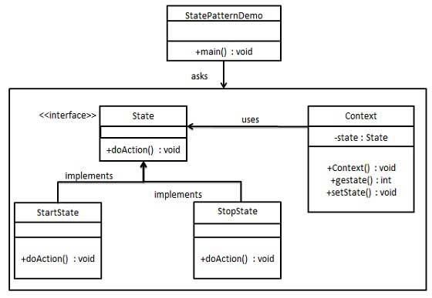
State Transition Flow Diagram on Liskov Substitution Principle:

Slide 9
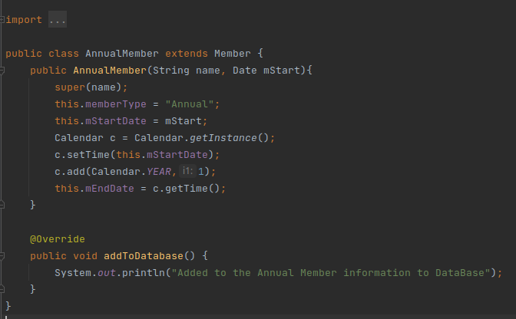
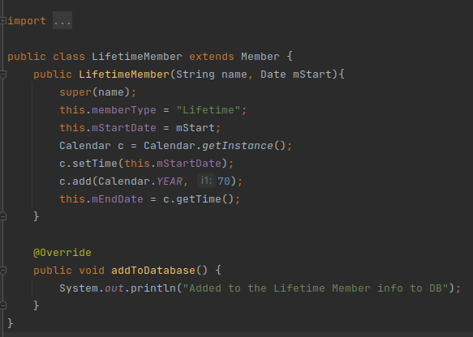
Let’s take a look at an example:
Suppose, there are two classess “AnnualMember” & “LifetimeMemer” which has an abstract class “Member” the functionality used to add the member in DataBase.

Slide 10
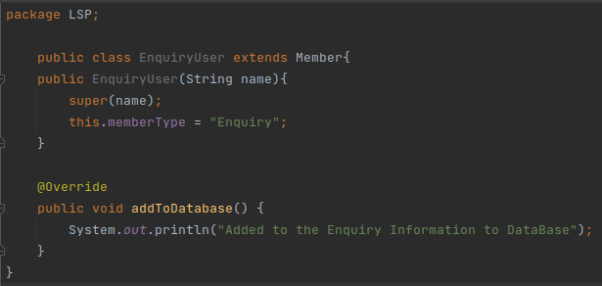
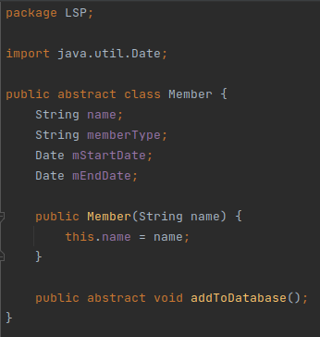
Above example violates the Liskov Substitution Principle because the “AnnualMember class has extra constraints :so now there is used abstract member class which describe the Liskov Substitution Principle.

Slide 11
3.Dependency Inversion Principle:
The general idea of this principle is as simple as it is important: High-level modules, which provide complex logic, should be easily reusable and unaffected by changes in low-level modules, which provide utility features. To achieve that, you need to introduce an abstraction that decouples the high-level and low-level modules from each other.
Based on this idea, Robert C. Martin’s definition of the Dependency Inversion Principle consists of two parts:
High-level modules should not depend on low-level modules. Both should depend on abstractions.
2.Abstractions should not depend on details. Details should depend on abstractions.

Slide 12
An important detail of this definition is, that high-level and low-level modules depend on the abstraction. The design principle does not just change the direction of the dependency, as you might have expected when you read its name for the first time. It splits the dependency between the high-level and low-level modules by introducing an abstraction between them. So in the end, you get two dependencies:
the high-level module depends on the abstraction, and
the low-level depends on the same abstraction.
Lets take an example of Dependency Inversion Principle where there is a car class having different functionality like – DieselEngine, PetrolEngine which having Data inversion of classes:-

Slide 13
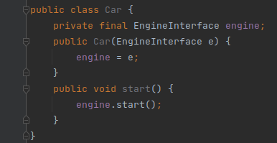
In the above code, we’ve implemented the Dependency Inversion Principle, as in the refactored code, high-level classes don’t depend on low-level classes, either.

Slide 14
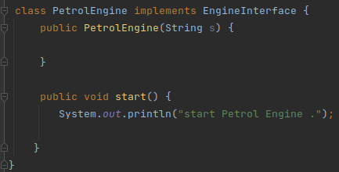
Now an PetrolEngine can be used to operate any appliance
In the above code, as the high-level Shelf class depends on the low-level Book, the above code violates the Dependency Inversion Principle. In order to fulfil the demand, we create PetrolEngine class:

Slide 15
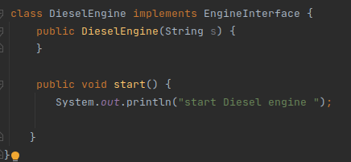
An abstraction is needed for the appliances too so that they have the common behaviour towards Car engine:
Hence, High Level Modules do not depend on Low level Modules. Hence, the Dependency Inversion Principle stands.

Slide 16
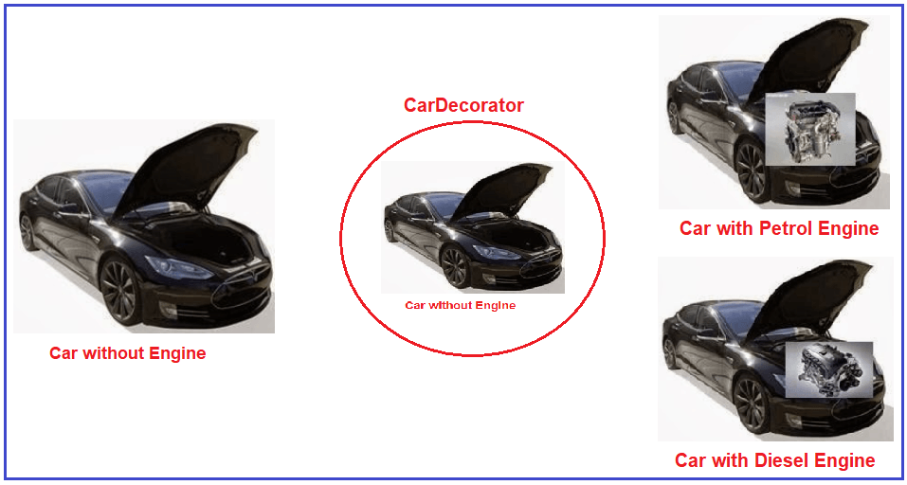

Slide 17

Thank You!

